Slide 1

Thermodynamic properties
Magne Guttormsen
Department of Physics
University of Oslo

Slide 2
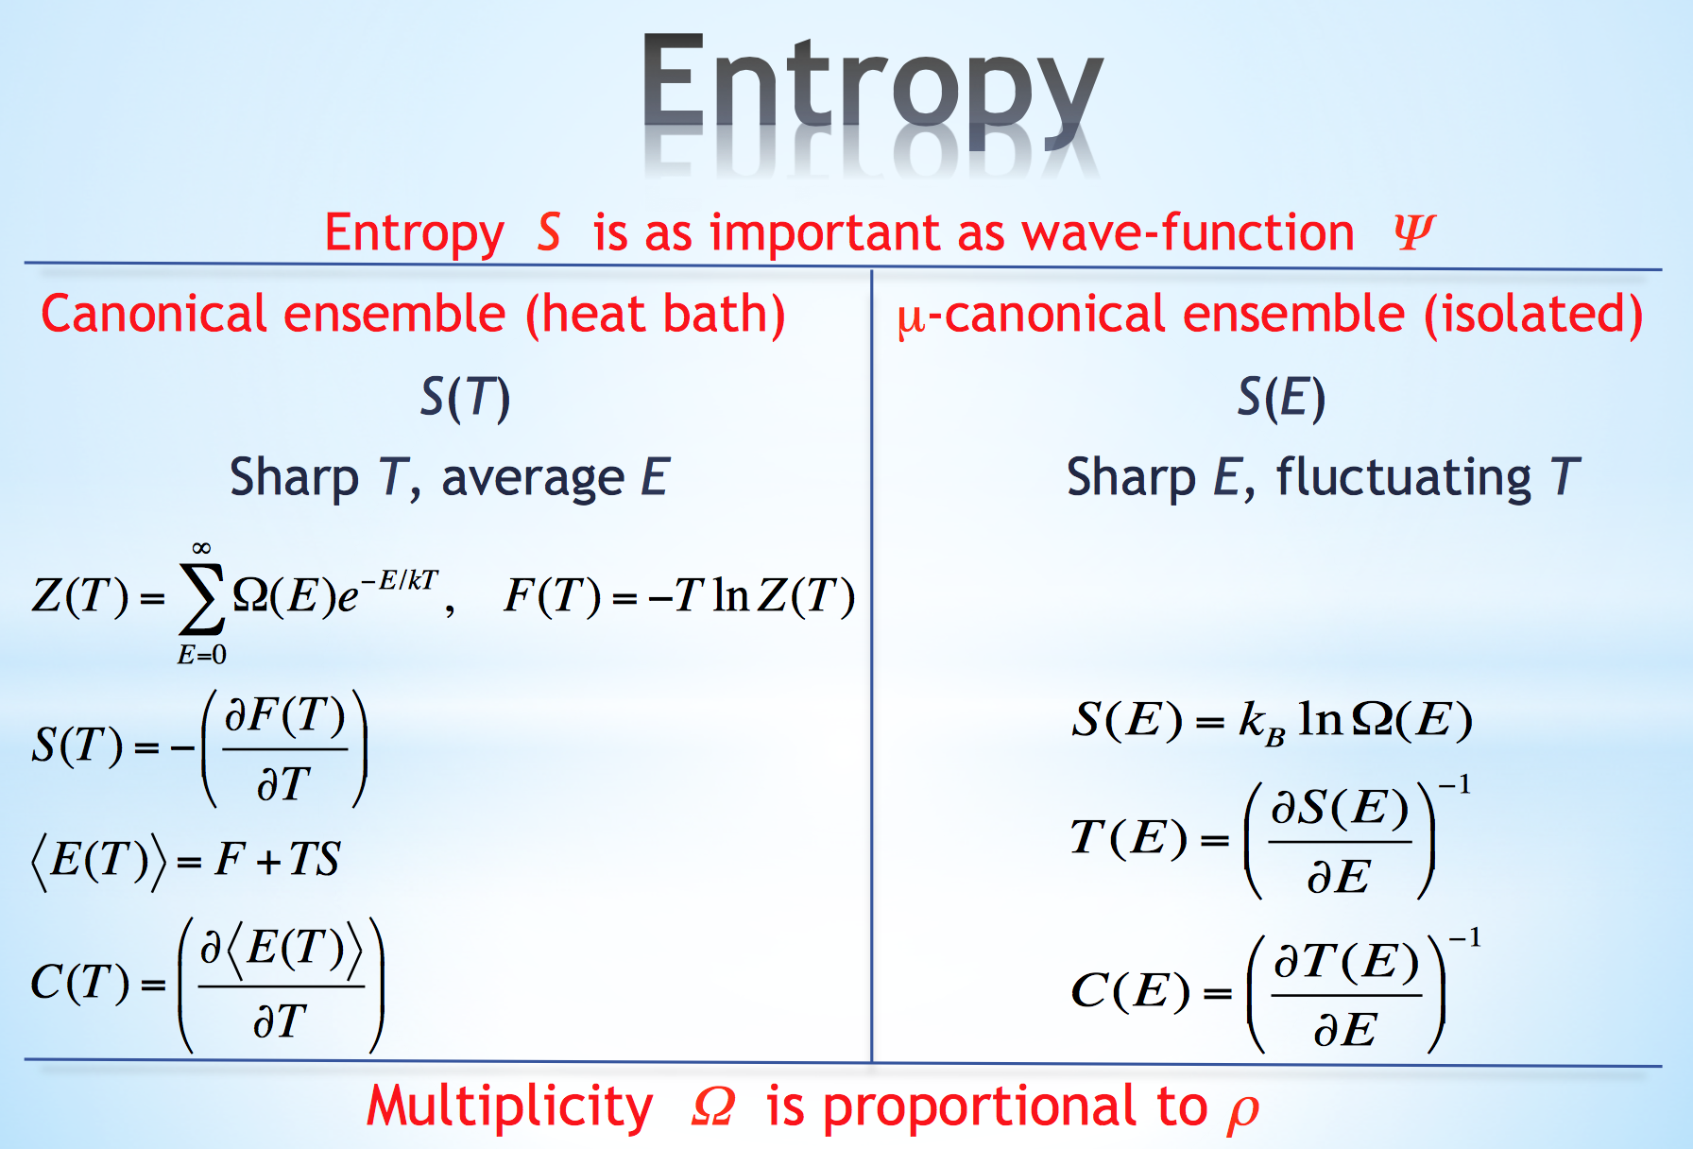

Slide 3
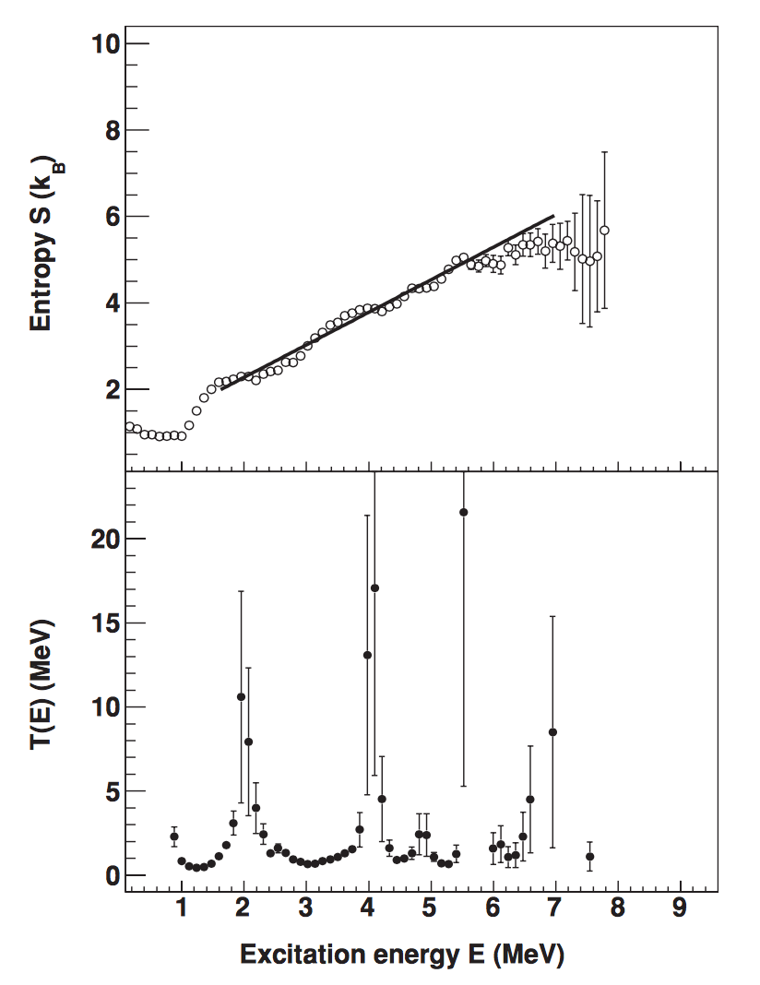
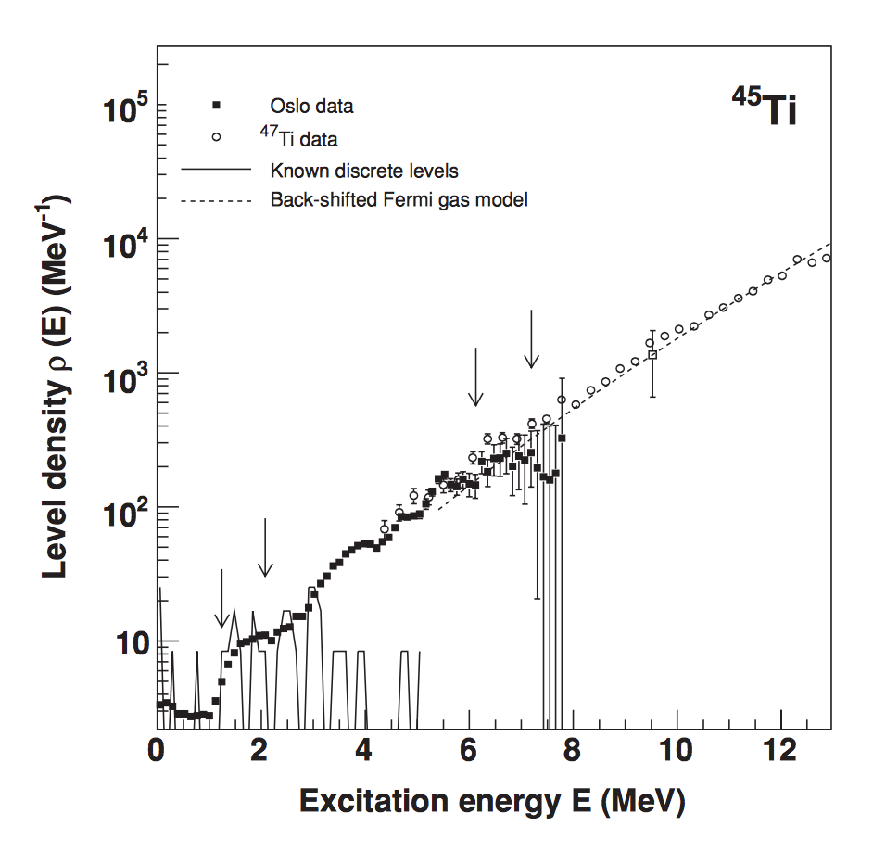
Case titanium
S = ln (ρ/ρ₀)
T = (dS/dE)⁻¹

Slide 4
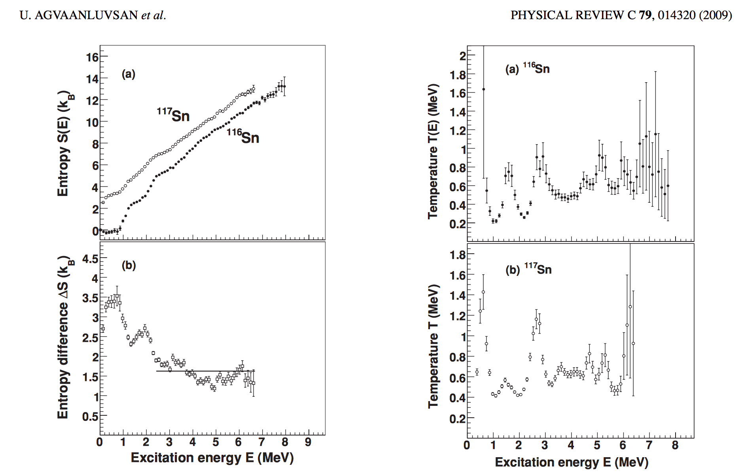
Case Tin
T = (dS/dE)⁻¹

Slide 5
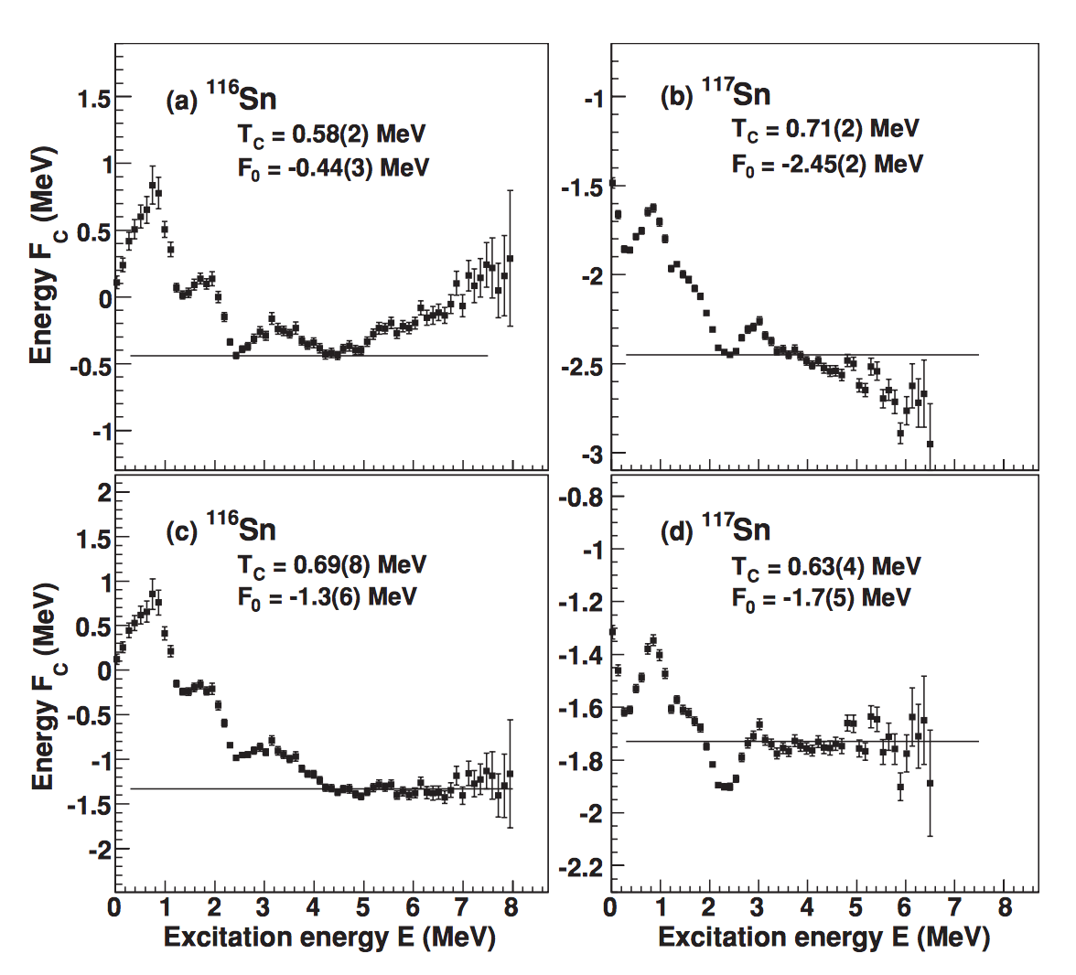
Case Tin
Helmholtz free energy ^{116,117}Sn
F_{c}(E) = E – T_{c} S(E)
F_{c}(E₁) = F_{c}(E₂) =F₀
Jooyoung Lee and J. M. Kosterlitz,
Phys. Rev. B 43, 3265 (1991)
U. Agvaanluvsan et al., PRC 79, 014320 (2009)

Slide 6
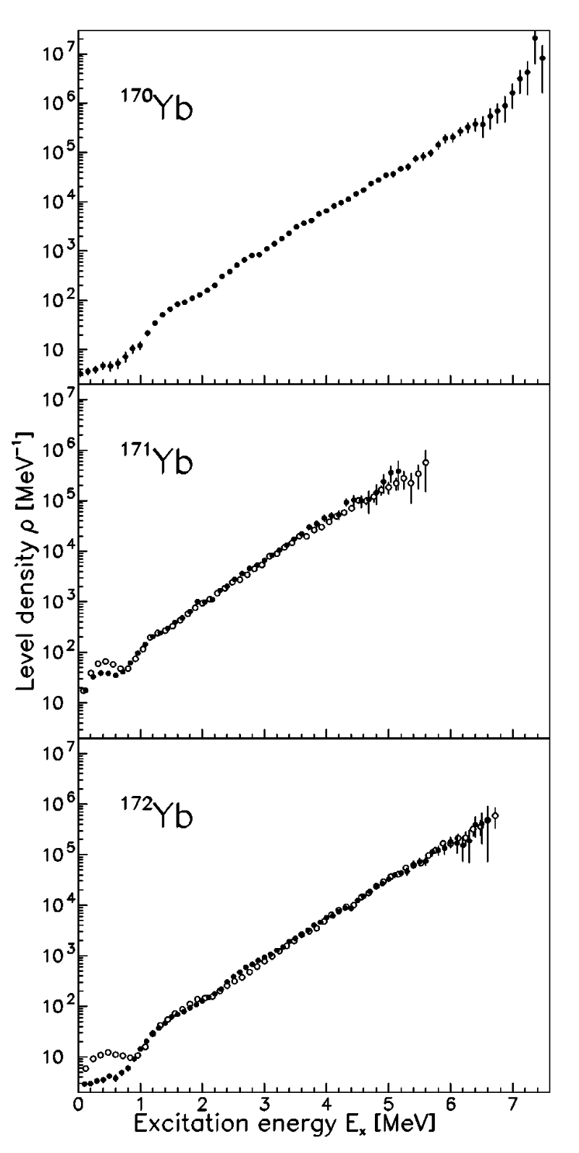
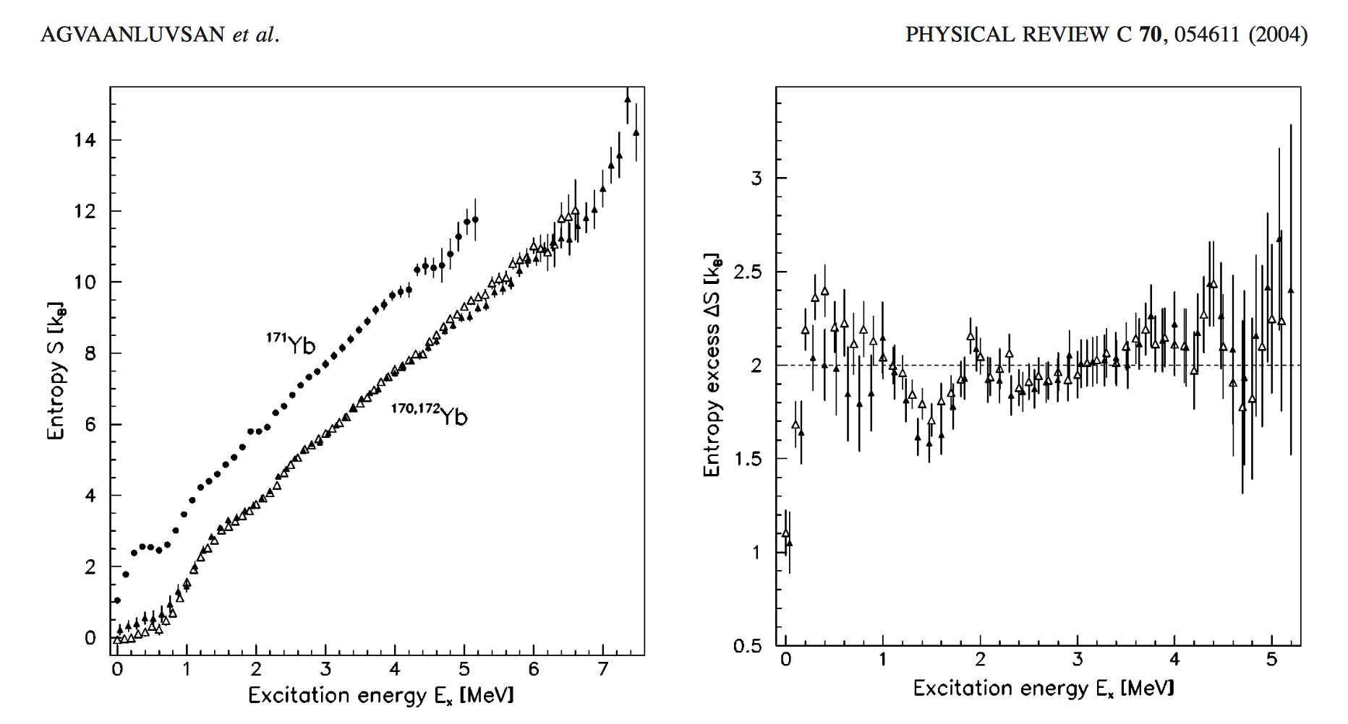
Case ytterbium, single qp entropy T_{c} = ∆/∆S

Slide 7
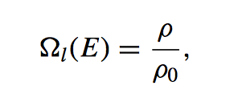
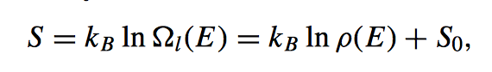
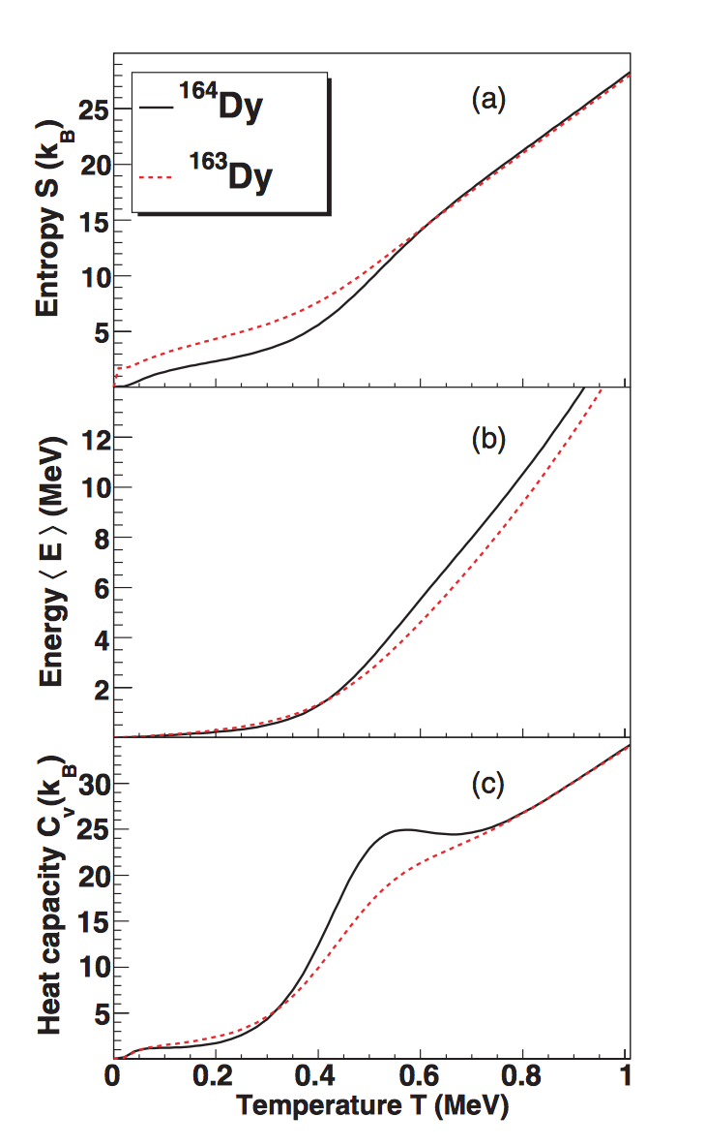
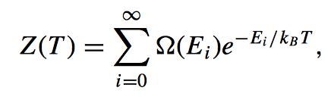
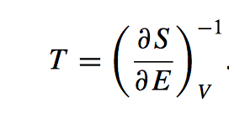
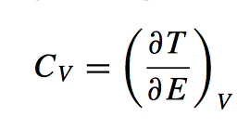
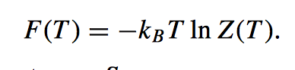
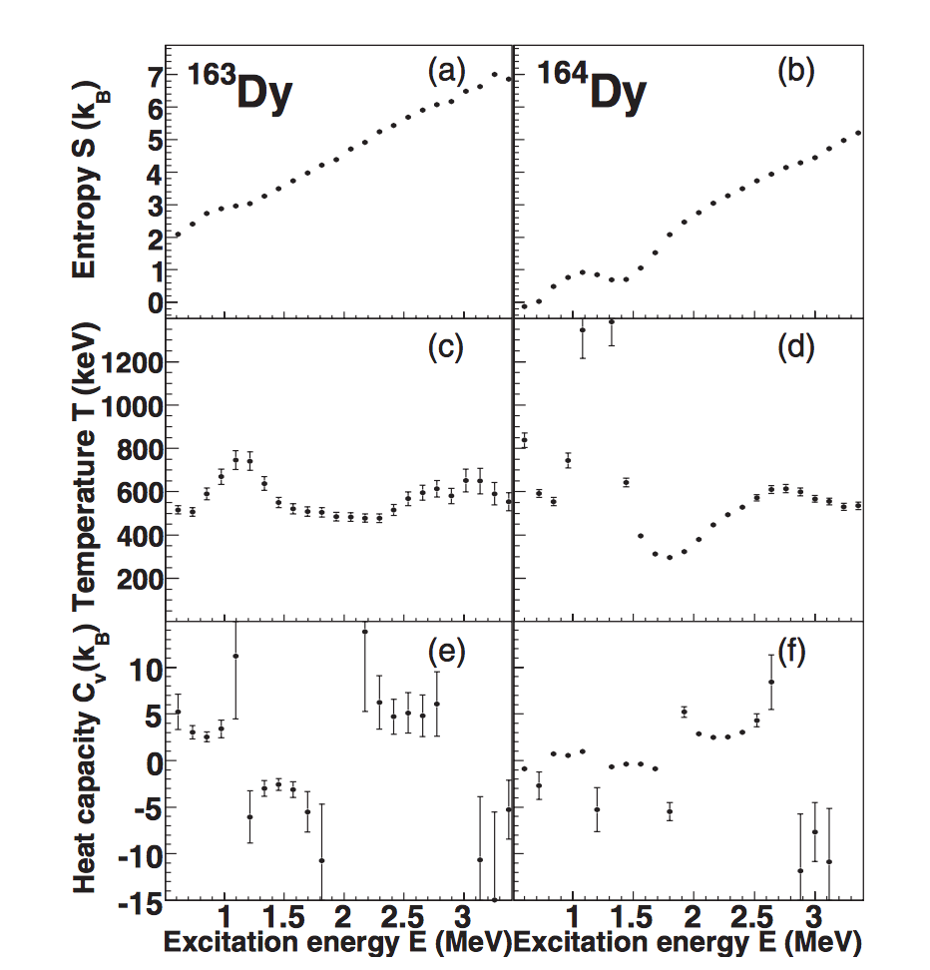
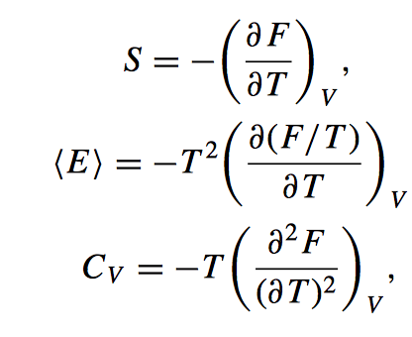
Case dysprosium, μ−canonical and canonical ensemble
H.T. Nyhus et al., PRC 88, 014323 (2012)

Slide 8
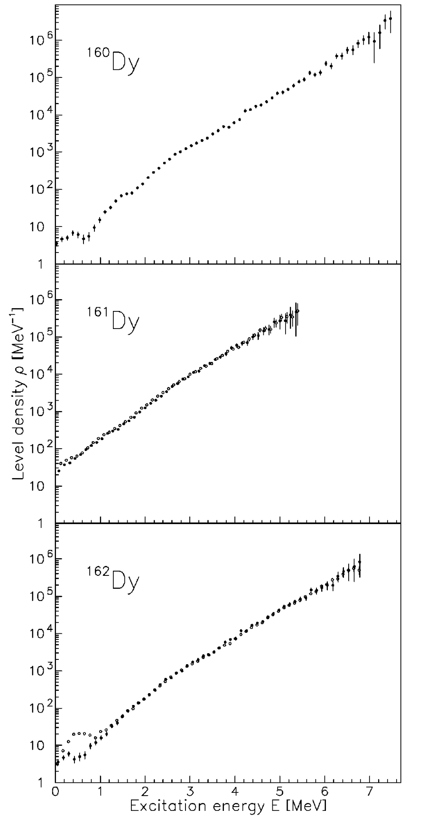
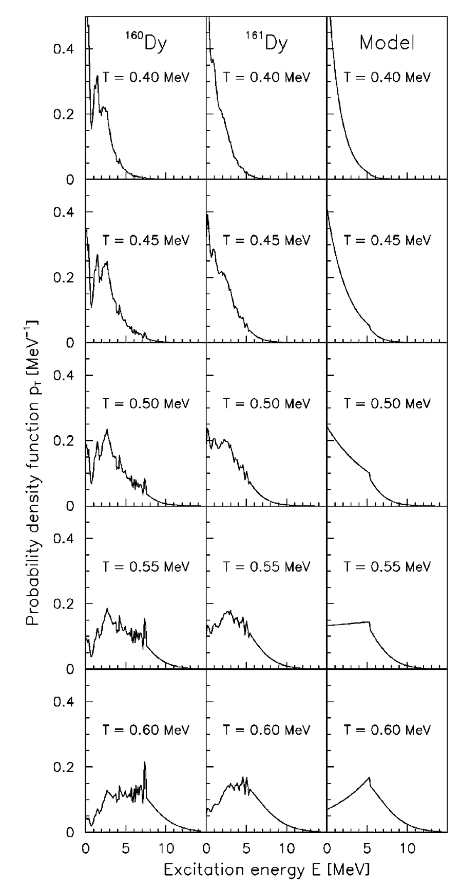
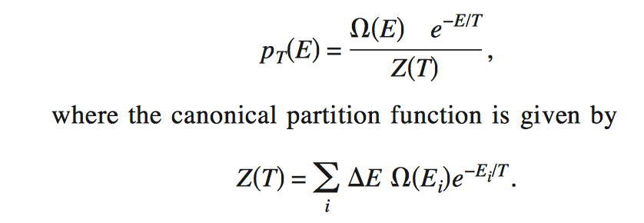
Case dysprosium
M. Guttormsen et al.,
PRC 68, 064306 (2003)

Slide 9
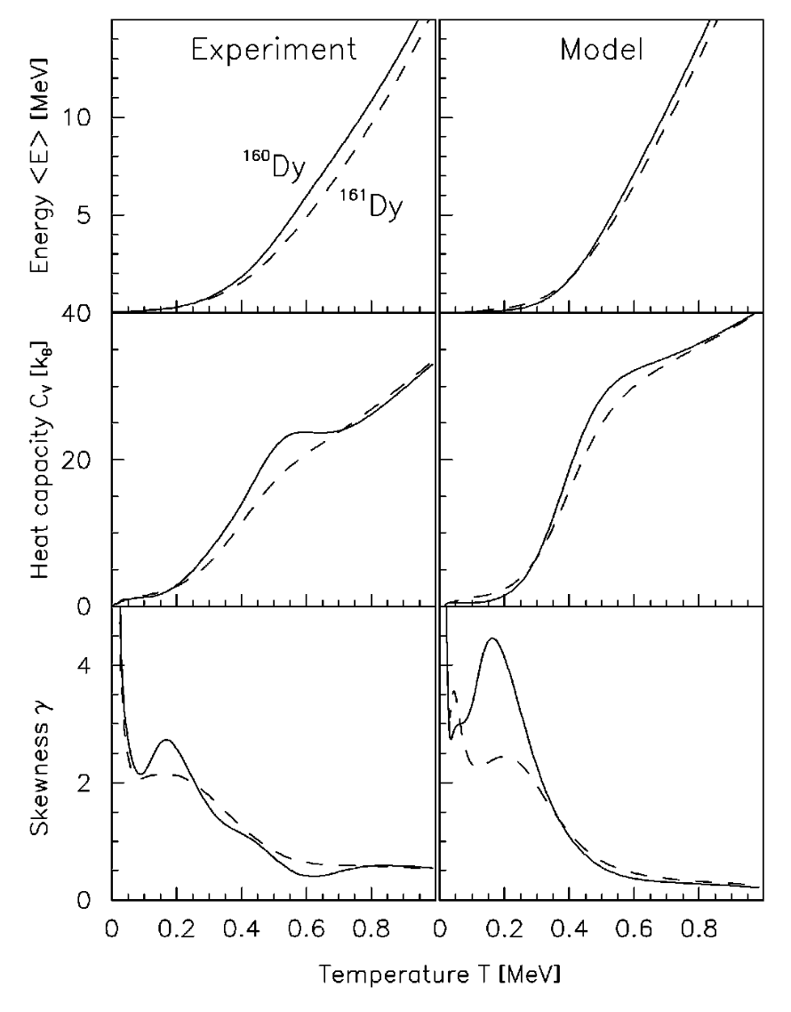
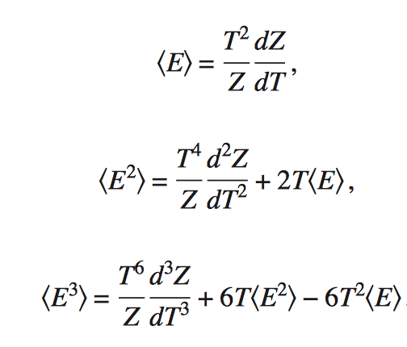
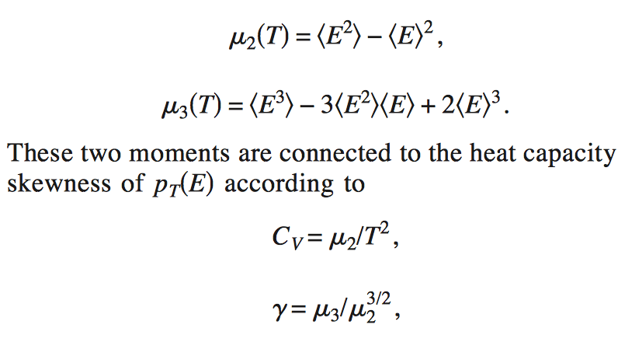
Case dysprosium
M. Guttormsen et al., PRC 68, 064306 (2003)

Slide 10
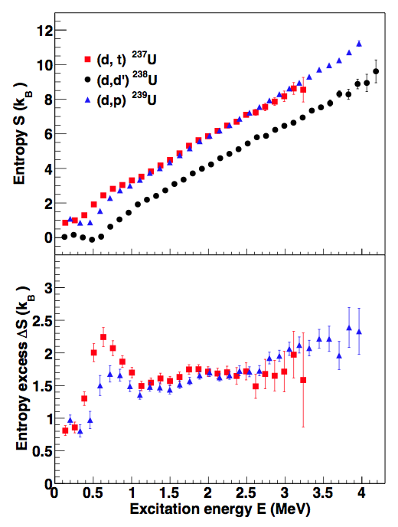
Case actinides
M. Guttormsen et al., PRC 88, 024307 (2014)
²³⁸U
^{237,239}U

Slide 11
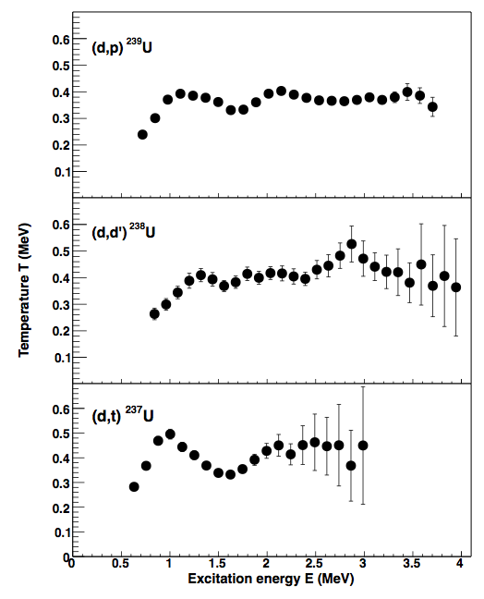
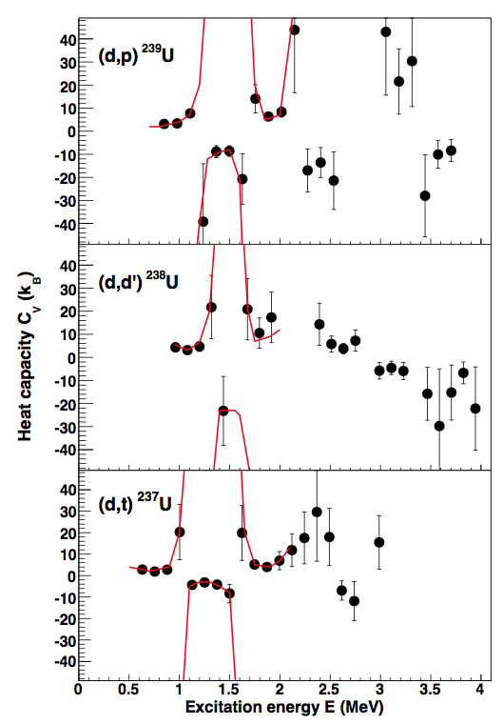
Case actinides
M. Guttormsen et al.,
PRC 88, 024307 (2014)

Slide 12

Thank you !
Mr. Osbome, may I be excused? My brain is full.

